Slide 1
DOMESTIC VIOLENCE
& GENDER BASED VIOLENCE PREVENTION
TEAM CRYPTO SCIENTISTS

Slide 2
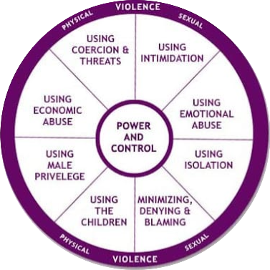
DOMESTIC VIOLENCE
Domestic violence is violence committed by someone in the victim's domestic circle. This includes partners and ex-partners, immediate family members, other relatives and family friends. The term 'domestic violence' is used when there is a close relationship between the offender and the victim.

Slide 3

01
03
PSYCHOLOGY TEST
PREVENTION
MEASURES
CAMPAIGNS
02
04
DEFINE &
MONITOR
ADOPTION FACILITIES

Slide 4

A game is a structured form of play, usually undertaken for entertainment or fun, and sometimes used as an educational tool. Games are different from work,

Slide 5


VIDEO AWARENESS
Publish a video awareness in tv commercials and youtube ADS, also in other social media
Make it as mandatary AD in TV commercials
MEASURES
PASS A LAW
Pass a law which can b helpful for victims of gender based violence

Slide 6
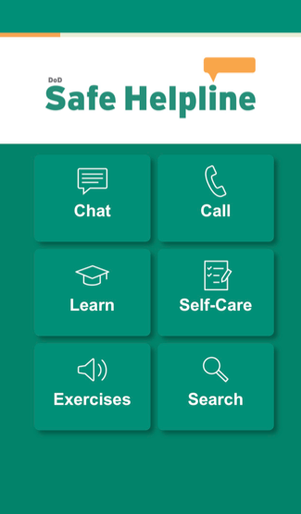

APP FOR PUBLIC SUPPORT
Create a application where a seperate team works in online mode. People can seek help via applicaion which also includes customer support number.

Slide 7




TEAM MEMBERS
SHAIKH ZAITH
SATHISH
RIZWAN
SULTHAN NIFAN

Slide 8
THANKS
TEAM CRYPTO SCIENTISTS

